Slide 1
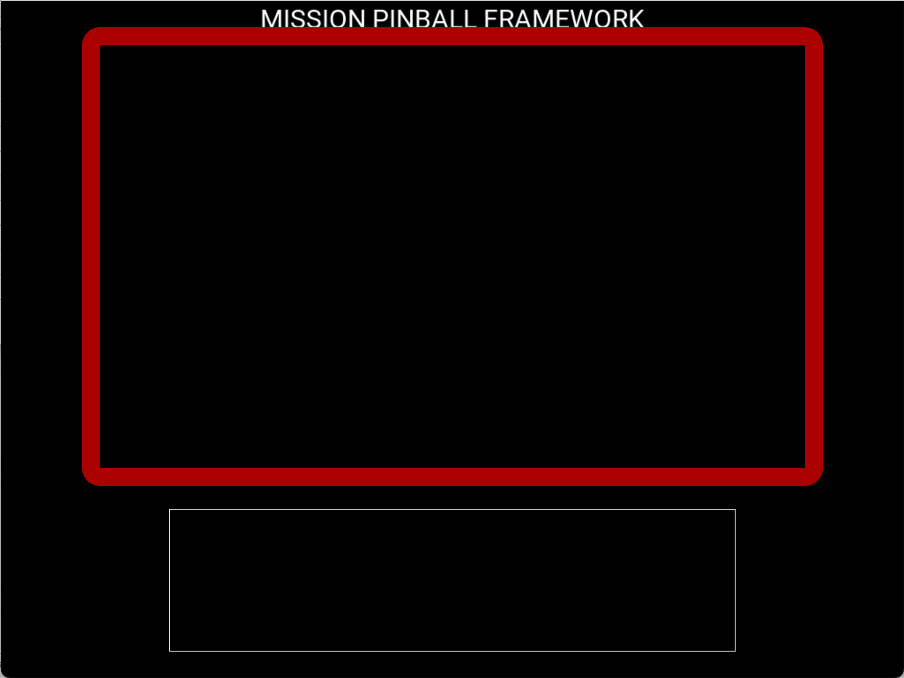
S – Start
P – Plunger Lane
L – Launch
D – Drain
T – Trough Enter
J – Jukebox Opto
X - Left Outlane
C – Left Inlane
Comma - Right Inlane
Period – Right Outlane
V – Left Sling
M – Right Sling
0 – Lower VUK Opto
1 – Start World Tour
2 – Start Money Bags
3 – Start Music Awards
4 – Start Jukebox
5 – Start Play Poker
6 – Start Jukebox Hurryup
7 – Start Metal Rodeo
8 – Start Honky Tonk MB
9 – Spinner
Z – Left Flipper O – Right Flipper

